Slide 1
Mini-école « fluides géophysiques »
M2 Physique ENS de Lyon, 16-20 janvier 2023
antoine.venaille@ens-lyon.fr

Slide 2
Geophysical Waves

Slide 3
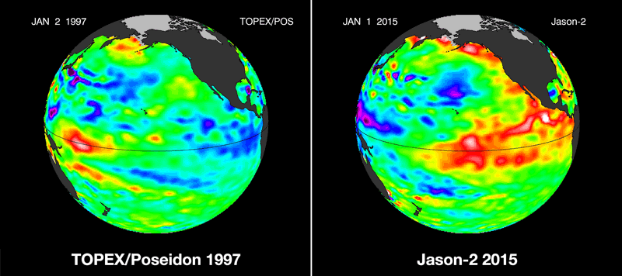
Equatorial wave guide

Slide 4
Planetary surface waves, Tides

Slide 5
Rossby waves Wesward propagation at midlatitudes

Slide 6
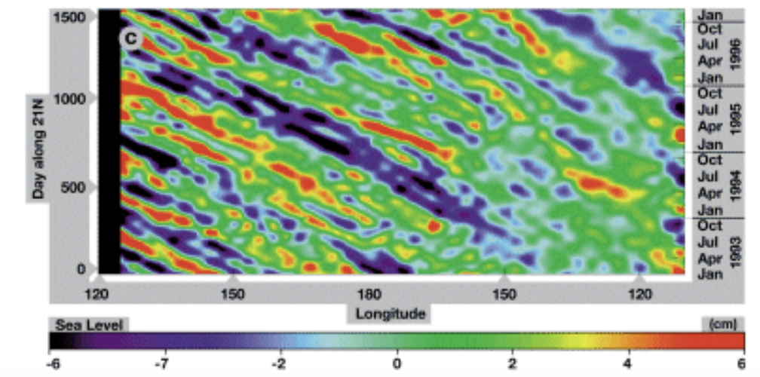
Rossby waves
$$\frac{L}{T}≈0.1m/s$$
$$T$$
$$L$$
Chelton and Schlax, Science 1996

Slide 7
Ocean currents
https://svs.gsfc.nasa.gov/3912
There is a huge number of scales involved in the dynamics
Notes:
-Reanalisis: observations (sparse)+numerical model= assimilation technics (revolutionalize currently with IA?). ECCO2 uses the MIT general circulation model (MITgcm)
-Notice different time scale of the dynamics (larger) and small scales (vortices are smaller than in the atmosphere): another challenge for modellers. From planet to 1m mixing.
-equation are slightly different than for atmosphere, but same class of PDE, so same kind of numerical methods.

Slide 8
Internal gravity waves in stably stratified flows

Slide 9
Internal gravity waves
Internal gravity waves in stably stratified flows
$$ω=±Ncosθ$$
$$θ$$

Slide 10
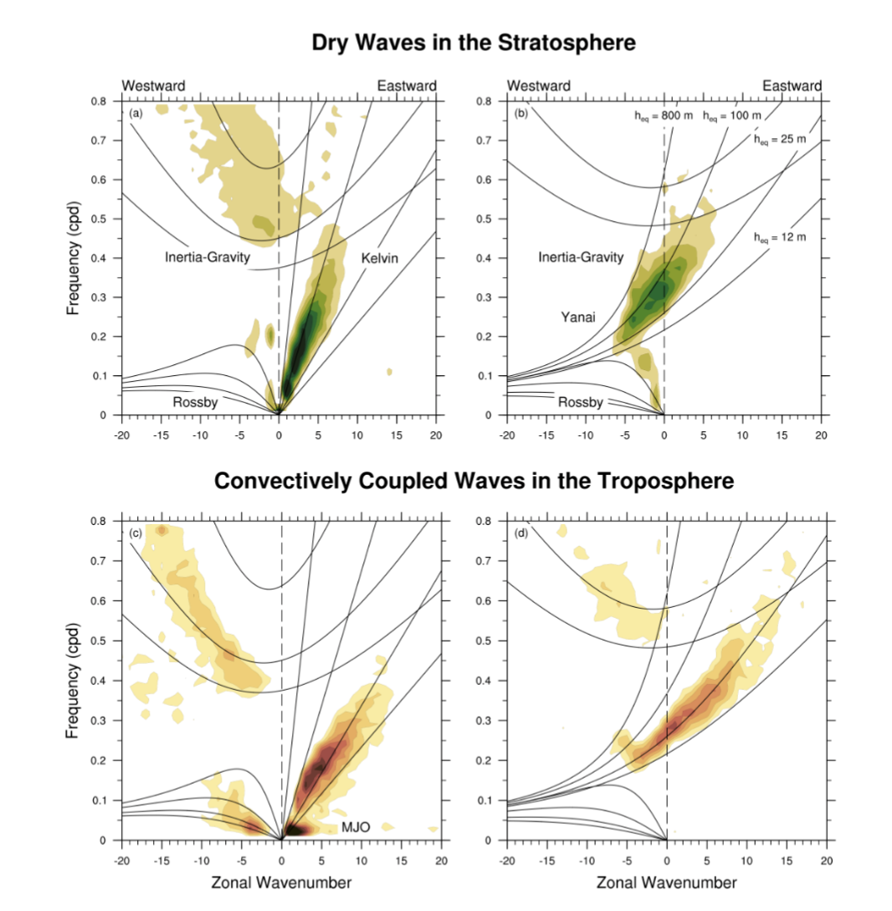
Wheeler-Kiladis Spectra for the equatorial waveguide
Figure by Juliana Dias and Yuan-Ming Chen

Slide 11
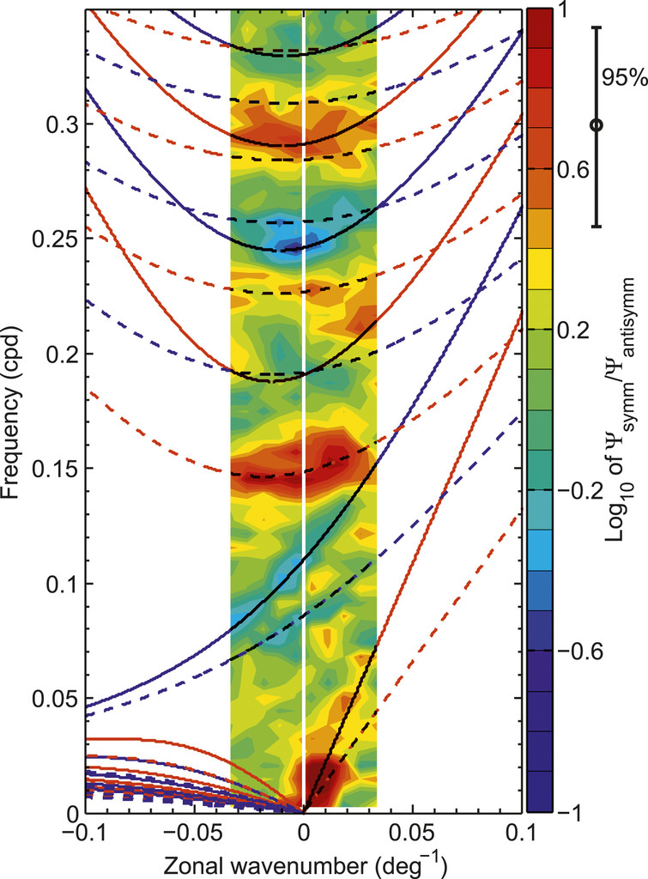
Oceanic waveguide
a)
b)
Farrar and Durland JPO 2012
$$z$$
$$f$$
$$g$$
$$η_{s}$$
$$0$$
$$(u,v)$$
$$ρ$$
$$η_{i}$$
$$-H$$
$$ρ+Δρ$$
$$Δρ≪ρ$$
$$(x,y)$$
$$η=-η_{i}≫η_{s}$$
$$c=\sqrt{\frac{Δρ}{ρ}gH}$$
https://journals.ametsoc.org/view/journals/phoc/42/11/jpo-d-11-0235.1.xml?tab_body=fulltext-display

Slide 12
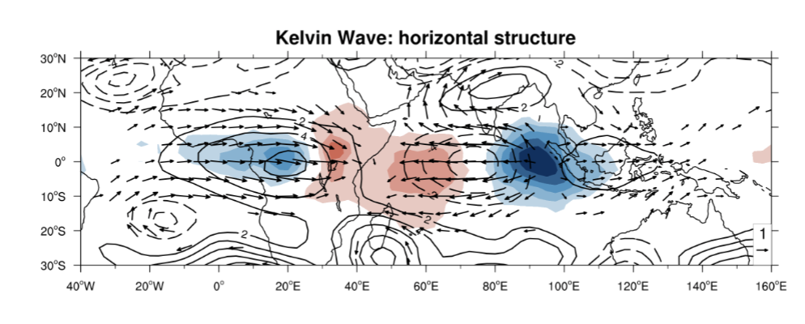
Figure by Juliana Dias and Yuan-Ming Chen

